Slide 1
Recursion

Slide 2
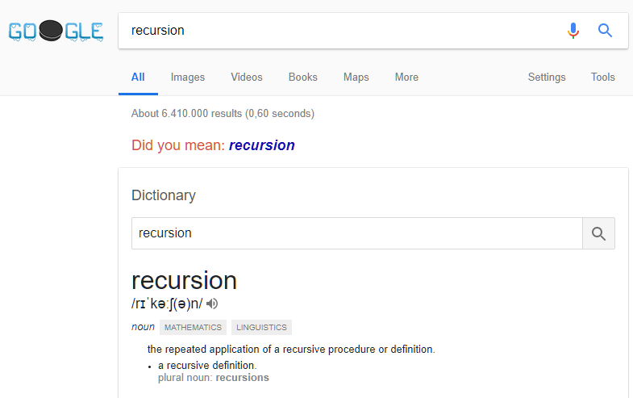

Slide 3
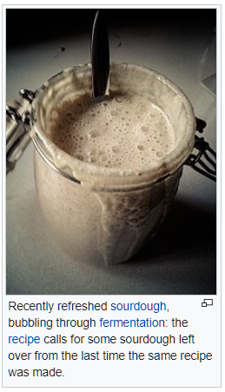

Slide 4

public void PrintHello()
{
Console.WriteLine("Hello");
PrintHello();
}

Slide 5
public void PrintHello(int callsLeft)
{
if (callsLeft > 0)
{
Console.WriteLine("Hello");
PrintHello(callsLeft - 1);
}
}

Slide 6
Parts of a Recursive definition
A trivial case: a case for which we have a simple solution, that does not require any calculation.
A division strategy: a way of splitting the problem into smaller parts, which can themselves be solved trivially or by recursion
A combination strategy: a way of combining the solutions for the simpler pro­blems into a solution for the original problem

Slide 7
Factorial
Factorial(n) = n x (n – 1) x (n – 2) x … x 2 x 1
Factorial(5) = 5 x 4 x 3 x 2 x 1 = 120
Factorial(1) = 1
Factorial(n) = n x Factorial(n – 1)

Slide 8
Parts of a Recursive definition (Factorial)
A trivial case: Factorial(1) = 1.
A division strategy: Split Factorial(n) into n (trivial) and Factorial(n - 1), which can be solved by recursion
A combination strategy: Multiply n and Factorial(n - 1).

Slide 9
public int Factorial(int n)
{
return (n <= 1) ?
1 :
(n * Factorial(n – 1));
}

Slide 10
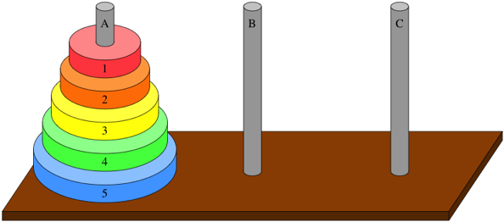

Slide 11
Parts of a Recursive definition (Towers of Hanoi)
A trivial case: n = 0, no disks to move.
A division strategy:
Move (n – 1) disks from A to B
Move disk n from A to C
Move (n – 1) disks from B from C
A combination strategy: The three steps in combination solves the original problem for n disks.

Slide 12
public void TowersOfHanoi(string pegA, string pegB, string pegC, int n)
{
if (n > 0)
{
TowersOfHanoi(pegA, pegC, pegB, n - 1);
Console.WriteLine("Move disk " + n + ": " + pegA + "->" + pegC);
TowersOfHanoi(pegB, pegA, pegC, n - 1);
}
}

Slide 13
Fibonacci
Fibonacci(1) = 1
Fibonacci(2) = 1
Fibonacci(n) = Fibonacci(n – 1) + Fibonacci(n – 2)

Slide 14
public int Fibonacci(int n)
{
return (n < 3) ?
1 :
Fibonacci(n – 1) + Fibonacci(n - 2);
}

Slide 15
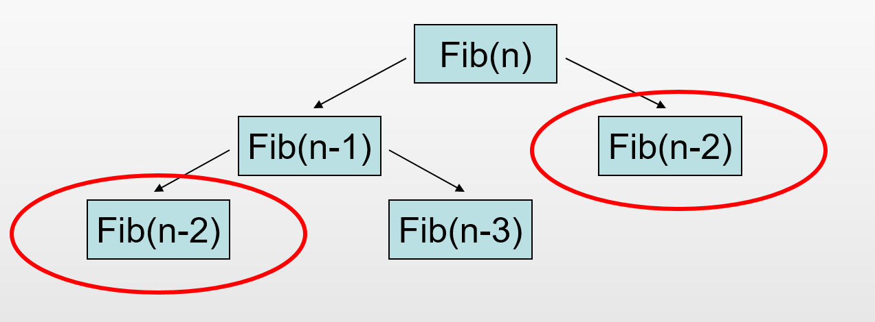

Slide 16

Recursion summary
Not a silver bullet!
Useful if problem has a natural recursive formulation, and/or non-recursive formulation is much more complex
Beware of efficiency

